Slide 1

Cultures of Safety in Corrections:
Building a Sexually Safe Culture
Month XX, XXXX
Staff Wellness

Slide 2
Staff Wellness Objectives
Recognize types of stress, common causes, warning signs, and dangers of heightened stress for staff and supervisors within the corrections workplace and the importance of staff wellness.
Discuss the reality-based scenarios and practical solutions for supervisors to address staff wellness.
Identify agency policy, resources, and programs that can be implemented for staff to utilize when they encounter incidents that tax their health and well-being.
Apply the principles of resiliency and strategies for wellness to deal with stress and burnout in the corrections environment.

Slide 3
What is Stress?
Job stress is defined as the relationship between the person and the environment where the environment is taxing or exceeding the person’s resources or endangering his well-being. (Carlson & Thomas, 2006)
Stress is consistently expressed by staff in corrections and juvenile justice as a significant contributing factor to personal health and well-being.
Joseph R. Carlson PhD & George Thomas PhD (2006) Burnout Among Prison Caseworkers and Corrections Officers, Journal of Offender Rehabilitation, 43:3, 19-34, DOI: 10.1300/J076v43n03_02
3
Notes:
As supervisors, you have an important role to monitor that the staff who you supervise are healthy and able to handle the responsibilities of the job. And, intervene when you notice that someone under your supervision is in not healthy (physically, mentally, etc.) enough to perform the functions of the position or is exhibiting stress.
How can you help? How do you deal with stress?
How does stress effect you, your coworkers, and those whom you supervise where you work?

Slide 4

What causes stress?
Facility Population Related
Occupational
Psycho-social
Organizational/
Administrative
Correctional Officer Wellness and Safety Literature Review a CORRECTIONAL OFFICER WELLNESS AND SAFETY LITERATURE REVIEW Author Note Correctional Officer Wellness and Safety Literature Review i. (2013). Retrieved from https://s3.amazonaws.com/static.nicic.gov/Public/244831.pdf
4
Notes:
What are the four categories of stress correctional staff may experience?
Facility Population-related: threat of violence/threat of injury, gang activity, overcrowding, incarcerated person mental illness, substance abuse, suicide, other deviance (sex, contraband), etc.
Occupational (inherent to the profession): closed work environment, hyper-vigilance, role ambiguity (rehabilitation vs. punishment), physical demands of the job (standing, use of equipment), culture around asking for help, etc.
Organizational/administrative: mismanagement, poor leadership, poor perceptions of trust/support and fairness, inadequate resources/pay, understaffing, mandatory overtime/shiftwork, lack of confidential services, etc.
Psycho-social: fear, work/family conflict, media scrutiny, public misperceptions of profession, etc.

Slide 5
Effects of Stress on Staff
Research suggests that staff who work in corrections or juvenile justice are more at risk to experience the following:
Irritability
Physical injury
PTSD
Chemical or substance abuse
Low life expectancy rate
Domestic violence
Heart disease and Hypertension
Higher divorce rates
Suicidal ideation
Burnout
5
Ferdik, F.V. and Smith, H.P. Correctional Officer Safety and Wellness Literature Synthesis. National Institute of Justice,
US. Department of Justice, July 2017.
Notes:
If not properly managed, stress increases the risk for COs to suffer from heart disease, hypertension, diabetes and a host of other physical ailments.
Stress also weighs heavily on COs’ mental health and can lead to serious psychological distress, emotional disorders, and an elevated risk of suicide.

Slide 6
Effects of Employee Stress on the Agency
Research suggests correctional officer stress and burnout can have serious consequences for the correctional agency and the work environment in the institution:
Reduced work performance
Absenteeism
Employee Turnover
Increased training/ retraining costs
Browler, Jaime, Fort, James, White, Michael. Correctional Officer Wellness Safety Literature Review. National Institute of Justice, US. Department of Justice, July 2013.
6
Notes:
The effects of stress also extend to the correctional agency through reduced work performance, absenteeism, employee turnover and replacement costs for new employees. Job stress can negatively affect employees’ commitment to the organization and profession and can damage the quality of officer-supervisor relationships.
Job burnout can cause-
officers to withdraw from the job
negatively impact their effectiveness at work/impaired work performance (i.e., such as carrying out careless searches and inmate counts, some staff keep a second phone number to avoid unwanted calls pertaining to overtime and other work matters, which can result in staffing shortages)
high absenteeism, correctional personnel use more sick leave than other state workers, high numbers of staff leave the profession voluntarily, or as a result of physical and psychological problems resulting from stress must then be replaced.
Increased costs of recruitment, selection and training of new staff

Slide 7
Stress experienced by isolated correctional officers (COs)
A Brief Note on Stressors Unique to Correctional Officers that are in the minority:
The term "minority" doesn't only imply a racial or ethnic group. Supervisory COs, women, non-native English speakers, and others can all be in the "minority" of the CO population.
COs that feel alone or isolated experience all the categories of stress described above, and additional stressors tied specifically to their minority status.
Harassment and discrimination by colleagues and other persons in confinement can lead to isolation and alienation.
Supervisory COs frequently experience-
  Being on-call 24 hours a day, seven days a week.
  Expanded external responsibilities.
  Being positioned between leadership & subordinates
7
Notes:
Supervisory stress can also include:
Handling relations with the officers’ union, staff hostility or mistrust, pressures from central administration, political scapegoating and media exposure (Finn, 2000).
Line-level supervisors must walk a fine line between being responsive to the agency leadership while also representing the interests of their subordinates.
Supervisors also may find themselves in the role of disciplinarian while attempting to provide support, positive feedback and rewards for exemplary work performance.
Research on female CO stress includes:
Men and women see corrections work differently, and training might address how to create a more centered and balanced role-approach that is neither wholly 'hack or human service.' Female correctional officers, more often than men, cited this as a weakness of their correctional agency (Carlson, Anson, & Thomas, 2003)
Women are more adept at verbal communication and this helps them work with incarcerated persons, as a problem population (Carlson et al. 2003). (Britton,1997) pointed out that, although women are better at verbal communications, this may not help them get raises or promotions since the physical work of controlling violent inmates is considered more valuable.
However the link between gender and stress is becoming less well defined as women are becoming more predominantly represented in the correctional staff population.

Slide 8
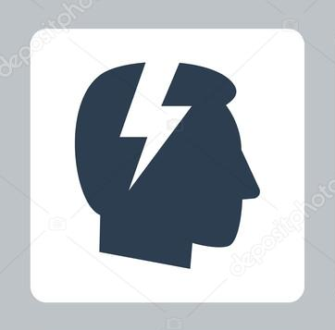

Staff Wellness State of Facility
High stress among staff can lead to disorder in a correctional environment which is indicative of the staff wellness state of the facility.
Stress
Facility Disorder
Ferdik, F.V. and Smith, H.P. Correctional Officer Safety and Wellness Literature Synthesis.
National Institute of Justice, US. Department of Justice, July 2017.
8

Slide 9
Small Group Activity
In your small group:
List warning signs and behaviors that staff members exhibit when they are under stress.
List warning signs and behaviors that supervisors and administrators exhibit when they are under stress.
Identify what may be the cause of stress and what you or your agency may be able to do to help reduce it.
How is stress an indicator of facility disorder? How can facility disorder contribute to an unsafe culture?
Be prepared to report out to the group.
9

Slide 10

Practitioner Perspective
Why is it important for a
supervisor to establish a
culture that supports staff wellness?
10
Notes:
As supervisors, aren’t always sure where the boundary is…
Often times growing up professionally, I didn’t realize the component of building the relationship with the staff that I worked with or that worked for me. So, one day, one of my mentors says to me, “how’s your staff, Aaron, doing?” I said that he was doing great and explained what he was working on. She asked, “well, how’s his kids?” And I didn’t know how his kids were. I didn’t know how many kids he had. And he had worked with me for a couple of years. It was her point to me that you have to know the personal things going on with the people who work for you. [Amy2 2:20 – 3: 03]
I was always very strong about work and home are two different things. I don’t want to talk about personal things with employees and I don’t want employees to ask personal things about my personal life. I just want to do the work. So, she helped me understand the importance of building those relationships. And as I began to find out more about staff’s kids and the sports they play, or the staff members’ I have that took care of their parents who were elderly, and checked in about those things, my staff didn’t just do the good work that they had been doing, but they did it with much more purpose and conviction then they had previously because I had demonstrated this need to get to know them. [Amy2 3:04 – 3:45]
How do you approach staff stress?

Slide 11
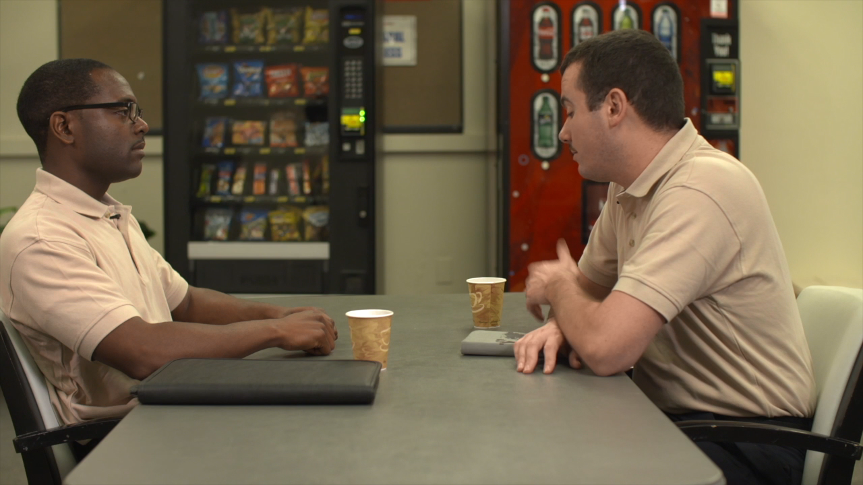
Staff Wellness Scenario, Part One
How might a staff handle this situation?

Slide 12
Part One
Clip Debrief
What are your thoughts so far?
What were the concerns of the two staff members?
What are other ways staff might handle a situation like this?
12

Slide 13
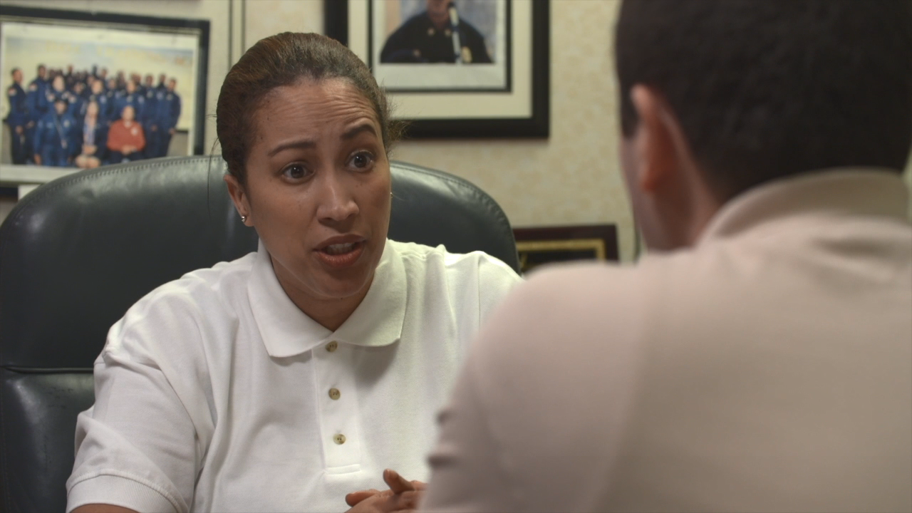
Staff Wellness Scenario, Part Two
How did the supervisor handle the situation?

Slide 14
Part Two
Clip Debrief
What were the key points that the supervisor addressed?
What did the supervisor do well or not do well?
Were other staff members affected by this stress? If so, how?
Are there other things the supervisor could have done or said?
14

Slide 15
Staff Wellness Policy
Agency policies for wellness usually consist of three types:
  An in-house program is a separate unit within—and operated by—the correctional agency.
  External arrangements involve regular use of a private service.
  Hybrid programs combine elements of both in-house and external structures.
What is ours?
15
Notes:
In-house examples include Massachusetts’ Stress Unit, Multnomah County’s Peer Support Program, New York State’s Post-Incident Stress Debriefing Program, Texas’ Post Trauma Staff Support Program.
External arrangements examples South Carolina’s Post Trauma Resources, California’s Counseling Team.
Hybrid programs include (Rhode Island’s Stress Unit and Family Service Society.

Slide 16
Strategies for Wellness
Journal
Exercise
Vacation
Eat well
Get sleep
Talk to someone
Respect boundaries
Learn your triggers
Know your rechargers
Delegate tasks
Manage your time
Organize and plan ahead
Don’t procrastinate
16
Notes:
In additional to agency policies on wellness, are there some things that we can do as supervisors to help staff with this?
(monitor PTO if someone isn’t using their vacation)
Regular check-ins with staff
Be organized and not wait until the last minute to post staff schedules, notify them of policy changes, etc.
Others?

Slide 17

Resilience
The process of adapting well in the face of adversity, trauma, tragedy, threats, or significant sources of stress. It means "bouncing back" from difficult experiences.
- American Psychological Association
17
Notes:
What can we do for ourselves and for our employees to encourage and strengthen our responses to stress and burnout?
Develop resilience.

Slide 18
Self-Regulation
Self-regulation and managing stressful situations are valuable tools for helping to navigate emotional and physiological well-being.
Creating a personal plan can be an effective and rewarding way to start the process.
18

Slide 19

Commitment Statement
“As a supervisor, to promote wellness with staff, I will continue to __________, stop _______, and begin to ___________.”
19

Slide 20
Additional PREA Resources
For more information on building a Sexually Safe Culture
Talk to the agency PREA Coordinator or the PREA Compliance Manager.
Visit the PREA Resource Center website: http://www.prearesourcecenter.org.
20

Slide 21
Thank you!
Have questions, comments, or concerns? Please reach out to
The Moss Group, Inc. at 202-546-4747 or info@mossgroup.us.

