Slide 1
PREA Employee Training
Notification of Curriculum Utilization
August 2014
The enclosed PREA Employee Training curriculum was developed by The Moss Group, Inc. as part of contract deliverables for the National PREA Resource Center (PRC), a cooperative agreement between the National Council on Crime and Delinquency (NCCD) and the Bureau of Justice Assistance (BJA). The Prison Rape Elimination Act (PREA) standards served as the basis for the curriculum’s content and development, with the goal of the PREA Employee Training curriculum being to satisfy specific PREA standard requirements.
It is recommended that the PREA Employee Training curriculum be reviewed in its entirety before choosing which modules to use. Any alterations to the original materials must either be acknowledged during their presentation or have the PRC and The Moss Group, Inc. logos removed.
BJA is currently undergoing a comprehensive review of the enclosed curriculum for official approval, at which point the BJA logo may be added.
Note: Use of the enclosed curriculum, either in part or whole, does not guarantee that an auditor will find a facility “meets standards.” Rather, an auditor
will take into consideration the curriculum used as part of their overall determination of compliance.

Slide 2
Unit 3 Part I:
Prevention and Detection of Sexual Abuse and Sexual Harassment
Notice of Federal Funding and Federal Disclaimer – This project was supported by Grant No. 2010-RP-BX-K001 awarded by the Bureau of Justice Assistance. The Bureau of Justice Assistance is a component of the Office of Justice Programs, which also includes the Bureau of Justice Statistics, the National Institute of Justice, the Office of Juvenile Justice and Delinquency Prevention, the Office for Victims of Crime, and the Office of Sex Offender Sentencing, Monitoring, Apprehending, Registering, and Tracking. Points of view or opinions in this document are those of the author and do not necessarily represent the official position or policies of the U.S. Department of Justice nor those of the National Council on Crime and Delinquency (NCCD), which administers the National PREA Resource Center through a cooperative agreement with the Bureau of Justice Assistance.

Slide 3

Introductions
Faculty
Participants
Name, Title
Experience with PREA and/or training
Name and Position

Slide 4
Employee Training Series Outline
This training is part of series of trainings to assist agencies with PREA Standards 115.31, 115.131, 115.231, and 115.331.
Unit 1: The Prison Rape Elimination Act: Overview of the Law and Your Role
Unit 2: Inmates’ Rights to be Free from Sexual Abuse and Sexual Harassment and Staff and Inmate Rights to be Free from Retaliation for Reporting
Unit 3 Part I: Prevention and Detection
Unit 3 Part II: Response and Reporting
Unit 4: Professional Boundaries
Unit 5: Effective and Professional Communication with Inmates

Slide 5
Objectives for Unit 3, Part 1
Understand the dynamics of sexual abuse and sexual harassment in confinement settings
Learn how to detect signs of threatened and actual sexual abuse by understanding common reactions of victims of sexual abuse and sexual harassment and common behaviors of abusers
Apply learning objectives 1 and 2 to fulfill your responsibility under agency sexual abuse and sexual harassment prevention and detection policies and procedures

Slide 6
Key Terms
Sexual abuse
Voyeurism
Sexual harassment
Sexual victimization
Code of Silence
Trauma
Gender non-conforming

Slide 7
Key Terms Defined: Sexual Abuse of an Inmate by Another Inmate
Any of the following acts, if the victim does not consent, is coerced into such act by overt or implied threats of violence, or is unable to consent or refuse:
  Sexual contact
  Penetration of the anal or genital opening of another person, however slight, by a hand, finger, object, or other instrument; and
  Any other intentional touching
Source: National Standards to Prevent, Detect and Respond to Prison Rape Under the Prison Rape Elimination Act, 28 C.F.R. Part 115, Docket No. OAG-131

Slide 8
Key Terms Defined: Sexual Abuse of an Inmate by a Staff, Contractor or Volunteer
Sexual contact
Penetration
Any other intentional contact
Any attempt, threat, or request to engage in sexual activities
Any display by a staff member, contractor, or volunteer of his or her uncovered genitalia, buttocks, or breast in the presence of an inmate, detainee, or resident, and
Voyeurism by a staff member, contractor, or volunteer
Source: National Standards to Prevent, Detect and Respond to Prison Rape Under the Prison Rape Elimination Act, 28 C.F.R. Part 115, Docket No. OAG-131

Slide 9
Key Terms Defined: Voyeurism
An invasion of privacy of an inmate, detainee, or resident by staff for reasons unrelated to official duties, such as peering at an inmate who is using a toilet in his or her cell to perform bodily functions; requiring an inmate to expose his or her buttocks, genitals, or breasts; or taking images of all or part of an inmate’s naked body or of an inmate performing bodily functions
Source: National Standards to Prevent, Detect and Respond to Prison Rape Under the Prison Rape Elimination Act, 28 C.F.R. Part 115, Docket No. OAG-131

Slide 10
Key Terms Defined: Sexual Harassment
Sexual Harassment Includes
Repeated and unwelcome sexual advances, requests for sexual favors, or verbal comments, gestures, or actions of a derogatory or offensive sexual nature by one inmate, detainee, or resident directed toward another
Repeated verbal comments or gestures of a sexual nature to an inmate, detainee, or resident by a staff member, contractor, or volunteer, including demeaning references to gender, sexually suggestive or derogatory comments about body or clothing, or obscene language or gestures
Source: National Standards to Prevent, Detect and Respond to Prison Rape Under the Prison Rape Elimination Act, 28 C.F.R. Part 115, Docket No. OAG-131

Slide 11
Objective 1: Understand the Dynamics of Sexual Abuse and Sexual Harassment in Confinement
To meet this objective we will discuss:
How dynamics differ in confinement settings compared to the community
Vulnerable populations in confinement
Gender differences related to sexual abuse/harassment in confinement settings

Slide 12
Dynamics of Sexual Abuse in Confinement Settings
Consider how sexual abuse dynamics in confinement settings might differ compared to the community:
  Environmental differences
  Reporting challenges
  Vulnerable Populations
  Reasons that the abuse occurred
  Gender differences
  Imbalance of power (staff/inmate)
  Investigative process

Slide 13
Environmental Considerations
Inmate victims of sexual abuse can be subjected to seeing the perpetrator every day, this could be another inmate or a staff person
Due to the routine nature of daily life in facilities, the inmate may revisit the location of the abuse nearly everyday (cell, office, classroom, chapel)
Constant reminders of a traumatic event can greatly impact how inmates react to the abuse, can worsen the trauma already experienced, and can “trigger” the inmate to behave in unpredictable ways if they relive the incident
This can create safety concerns for staff and other inmates if not appropriately addressed

Slide 14
Reporting Considerations
Reporting any sensitive incident in the community or confinement can be very difficult
In confinement facilities, inmates may fear retaliation by staff or other inmates for reporting
Inmates may risk losing privileges that are very important to them or risk their safety
This can deter reporting in facilities that do not have strong reporting mechanisms and create a fear-based environment
Can you think of other considerations?

Slide 15

Inmate Reporting Rates
According to BJS data, the majority of sexual abuse cases in confinement go unreported
Only 37% percent of victims of inmate-on-inmate sexual abuse reported the abuse to staff
That means that nearly 2/3 of the inmates who were victimized by another inmate never made a report
Source: Bureau of Justice Statistics, Sexual Victimization Reported By Former State Prisoners, 2008, May 12, 2012.
Source: Bureau of Justice Statistics, “Sexual Victimization in Prisons and Jails Reported by Inmates, 2011-12” (May, 2013)
Source: U.S. Department of Justice, National Crime Victimization Survey: 2006-2010.
Notes:
Reporting Rates
The overwhelming majority of cases of sexual abuse in confinement go unreported. There are many reasons for the low reporting rates, which we will explore in a moment.
According to BJS research of former inmates, only 37% percent of victims of inmate-on-inmate sexual abuse reported the abuse to staff. That means that nearly 2/3 of the inmates who were victimized by another inmate never made a report.
Source: Bureau of Justice Statistics, Sexual Victimization Reported By Former State Prisoners, 2008, May 12, 2012.
The most recent BJS study shows that reporting rate for staff sexual misconduct is even lower. A mere 5.8% of victims of staff sexual misconduct reported the abuse, which means that 94% of victims of staff sexual abuse never came forward.
Source: Bureau of Justice Statistics, “Sexual Victimization in Prisons and Jails Reported by Inmates, 2011-12” (May, 2013).
The low reporting rate of sexual abuse in confinement mirrors what happens in the community, where, at best, 46% of rapes are reported. That means the majority of victims of sexual abuse in the community also choose not to report.
Source: U.S. Department of Justice, National Crime Victimization Survey: 2006-2010.

Slide 16
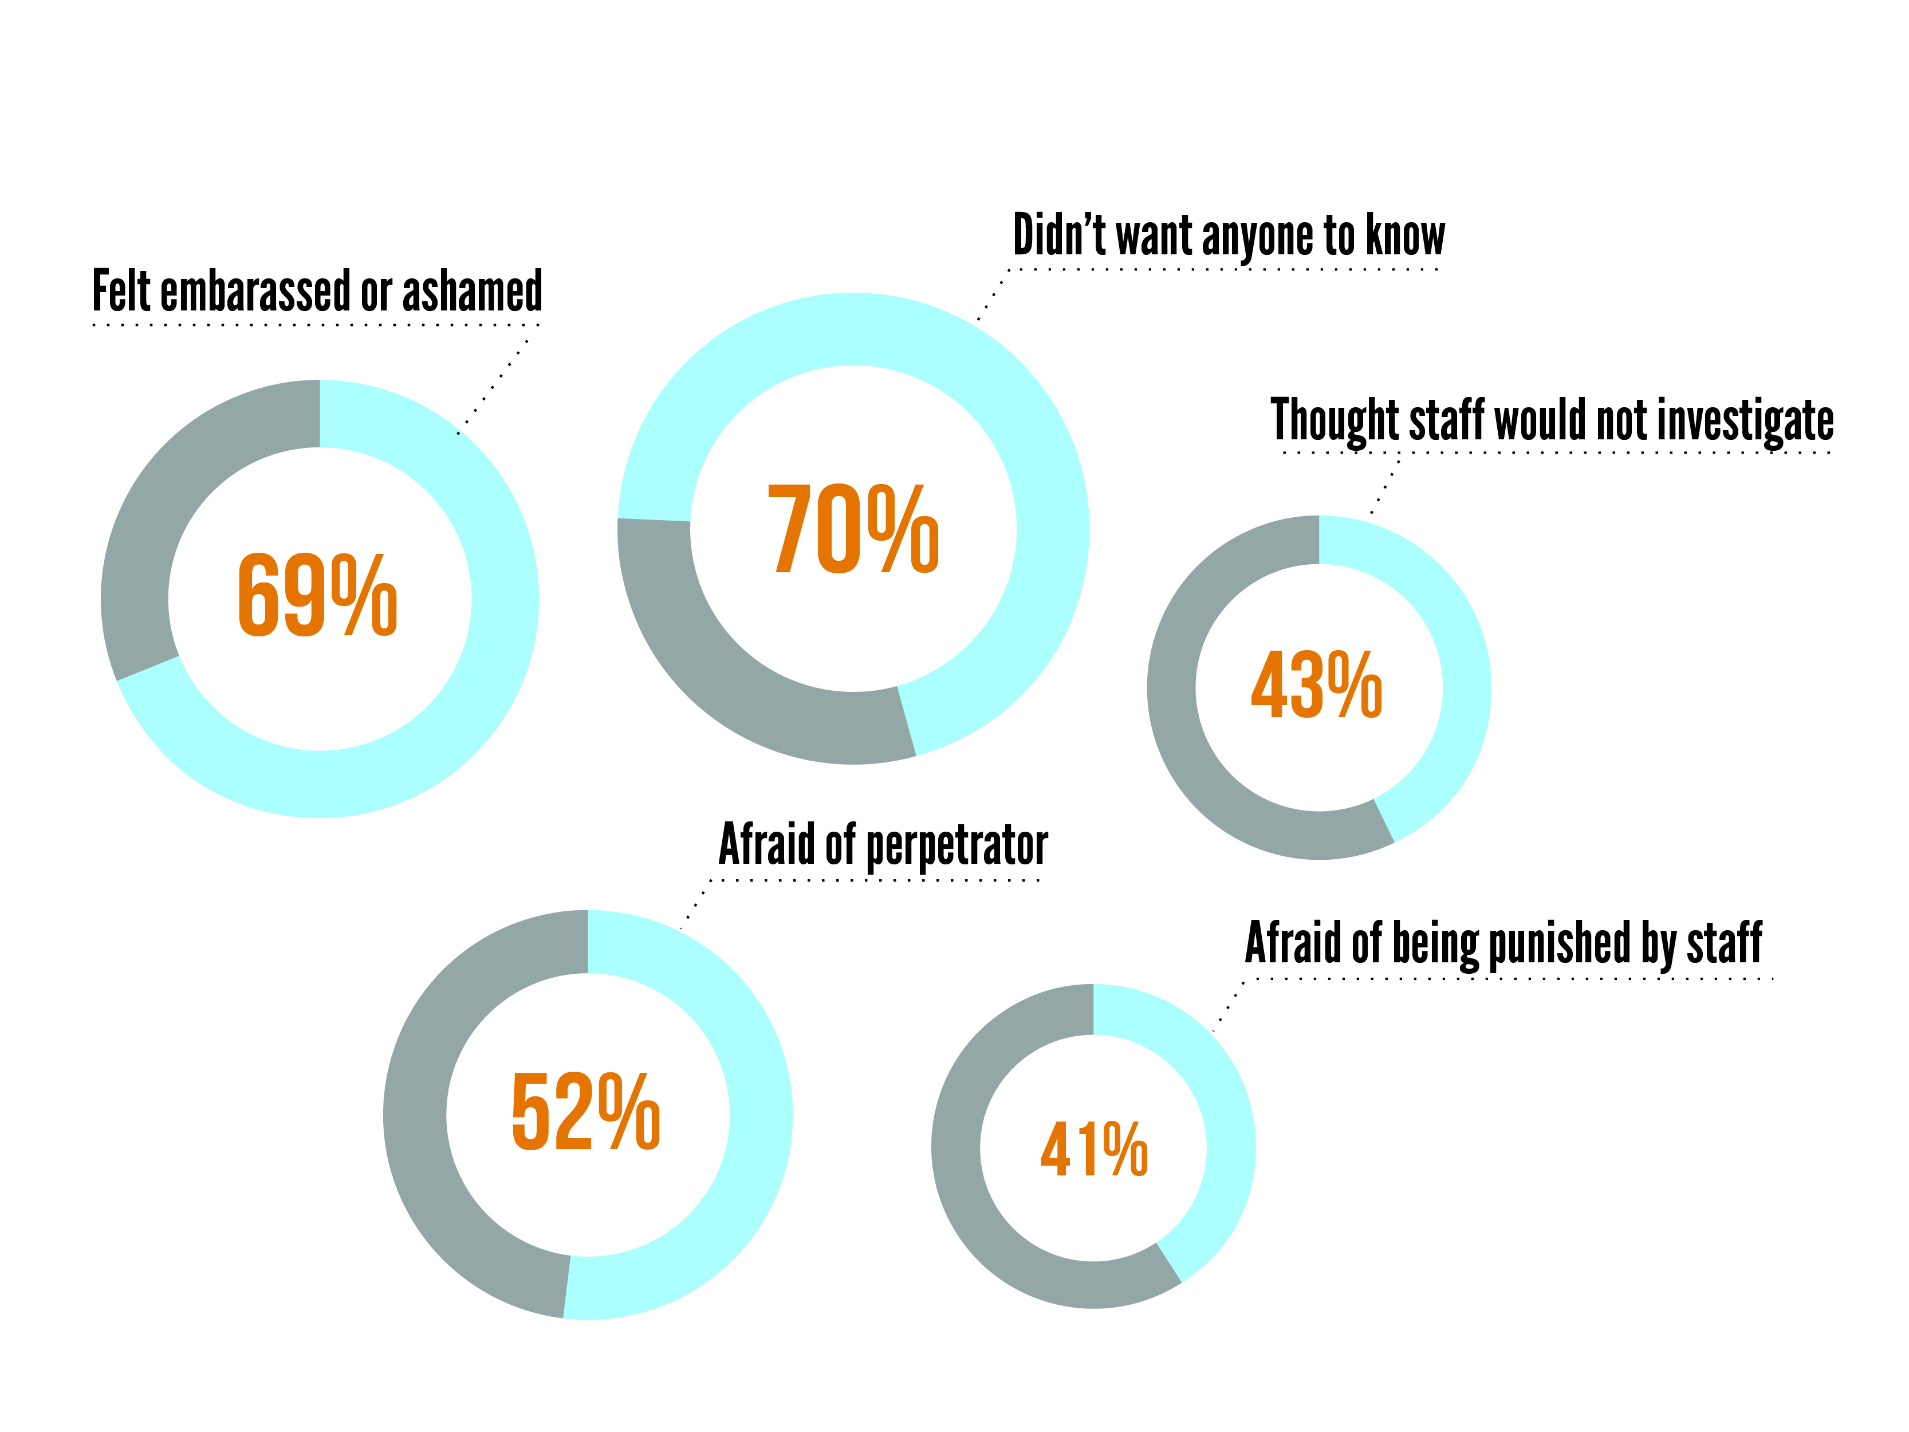
Reasons Victims Did Not Report
Graphic by Just Detention International. Source: Bureau of Justice Statistics, "Sexual Victimization Reported By Former State Prisoners, 2008,“ May 12, 2012.
Notes:
Reasons Victims Did Not Report (Slides 44-46, 6 minutes)
This slide illustrates data from a national Bureau of Justice Statistics study which was “designed to encourage a fuller reporting of victimization, by surveying only former inmates, who are not subject to the immediate risk of retaliation from perpetrators or a code of silence while in prison.”
The vast majority of victims who did not report – 70% percent – reported that they did not want anyone to know, and 69% said they did not report out of shame or embarrassment.
A majority of these victims did not report because they were afraid of the perpetrator. Most likely, these victims were afraid of re-victimization by the perpetrator or by the perpetrators friends or colleagues.
Many of those surveyed said that they did not report sexual abuse while they were incarcerated because they thought they would get in trouble. For example, 40% thought they would be punished by staff, while 25% said they were afraid they’d be charged with making a false report. Many victims are afraid of isolation or a loss of privileges, including being transferred to Administrative Segregation, if they report. Other victims may fear retaliation if they report – such as being sent to a more secure jail, additional cell searches, or closer scrutiny.
Others thought that the facility would not take their report seriously. 40% of respondents who were sexually abused by another inmate thought either that their report would not be investigated, or that the perpetrator would not be punished. We will explore later when we talk about the facility response.
Other reasons why victims may not report sexual abuse while incarcerated include fear of being labeled a “snitch” if they come forward, and a lack of knowledge about how to report and what will happen to them if they do.
Source: Bureau of Justice Statistics, Sexual Victimization Reported by Former State Prisoners, 2008 (May 2012).
Image developed by Just Detention International

Slide 17
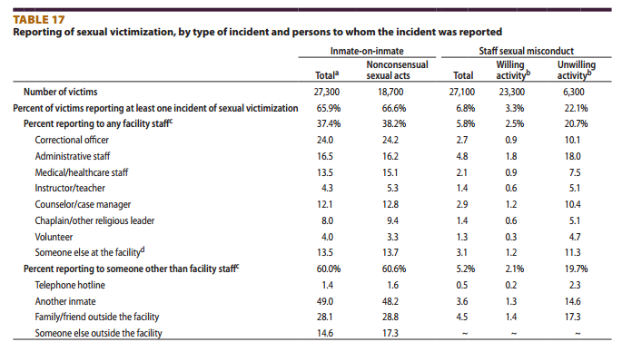
Reporting of Sexual Victimization: Persons to whom the Incident was Reported
Source: Sexual Victimization Reported by Former State Prisoners, 2008 | May 2012

Slide 18
Vulnerable Populations
Educating ourselves about the characteristics of the inmate population will greatly assist in preventing and detecting sexual abuse
We know what characteristics make an inmate more prone to victimization and abusive behavior to inform our work in prevention and detection
Notes:
Vulnerable populations

Slide 19
Vulnerable Populations (Prisons and Jails)
BJS data collection has helped us understand who might be more vulnerable in confinement settings, in adult prisons and jails vulnerable populations may include:
Inmates with mental illness or disability
Size of the inmate victim and correlation to victimization
Incarcerated for sexual violence
First time inmates/ younger inmates
Inmates perceived as LGBTI
Prior sexual victimization

Slide 20
Examples of Gender Differences Related to Vulnerable Populations
Male
Female
Physically small or weak
Gay
Transgender
Effeminate
Slight build
Previous victim of sexual abuse
Non-English speaking
Resource rich or poor
Notes:
Gender differences in male and female victims

Slide 21

Victimization Patterns
Overall, 31% of inmates reporting abuse were victimized 3 or more times
13% of male prison inmates and 19% of male jail inmates said they were victimized by other inmates within 24 hours after admission (vs. 4% of female inmates in prison and jail)
Inmate-on-inmate victimization was most commonly reported to have occurred between 6 pm-midnight (more than 40% reported in this time frame)
Nearly 16% of male victims of staff sexual misconduct in prison and 30% of male victims in jail said they were victimized within the first 24 hours (vs. 5% of female victims in prison and 4% in jail)
Source: Beck, Allen Ph.D. et al. (2009). Sexual Victimization in Prisons and Jails, 2007-2008. Washington, D.C. U.S. Department of Justice, Bureau of Justice Statistics

Slide 22
Dynamics of Sexual Abuse in Confinement: Reasons Sexual Victimization May Occur
Sexual victimization in a confinement setting may not always be used for the same purposes as victimization in the “free world”
Sexual harassment may precede sexual abuse and may be expressed to:
      Test a target
      Demean others
      Overtly or subtly intimidate
      Challenge new inmates/residents Threaten inmates/residents who are perceived to be weaker

Slide 23
Key Terms Defined: Sexual Victimization
To define sexual victimization under the Prison Rape Elimination Act of 2003, BJS uses uniform definitions that classify each sexual act by the perpetrator who carried it out (i.e., inmate or staff ) and the type of act
  Inmate-on-inmate sexual victimization involves sexual contact with a victim without his or her consent or with a victim who cannot consent or refuse
  Nonconsensual sexual acts
  Abusive sexual contacts
  Staff sexual misconduct
  Staff sexual harassment
Source: Beck, Allen, Ph.D. and Ramona R. Rantala, BJS Statisticians, Jessica Rexroat, BJS Intern, Special Report: Sexual Victimization Reported by Adult Correctional Authorities, 2009-11, Published January 2014. U.S. Department of Justice, Office of Justice Programs, Bureau of Justice Statistics. http://www.bjs.gov/content/pub/pdf/svraca0911.pdf

Slide 24
Coercion vs. Consent
Abusers may use force, entrapment or blackmail (such as bribes, alcohol and drugs)
Abusers may be coercive and sexually abusive relationships may be exchanged for protection as a survival mechanism
  These types of relationships can be difficult to distinguish from willing relationships
  As expert Bob Dumond says, “The question to ask yourself is: Would this individual be participating in this relationship if they were in the free world?”

Slide 25
Men and Women in Prison
Bureau of Justice Statistics. Prisoners in 2011. Washington D.C.: U.S. Department of Justice

Slide 26
Why Might Females Engage in Sexual Activity in Confinement?
Sex defined as “love” or as a commodity
Boundary issues
Challenges in defining domestic violence
Fears about disclosure and reporting
PTSD and re-traumatization
Crisis and long-term treatment issues
Trauma remains untreated and cycle continues
Source: Smith, Brenda. American University Washington College of Law/ Project on Addressing Prison Rape

Slide 27
Why Might Males Engage in Sexual Activity in Confinement?
Desire
Deprivation
Companionship
Favors or Benefits
Protection
Force
Source: Smith, Brenda. American University Washington College of Law/ Project on Addressing Prison Rape

Slide 28
Why Might Gender Non-Conforming Inmates Engage in Sexual Activity in Confinement?
Sex defined as “love” or as a commodity
Boundary Issue
Fears about disclosure and reporting
History of previous confinement and/or longer sentences
Favors or benefits
Protection
Force
Source: Smith, Brenda. American University Washington College of Law/ Project on Addressing Prison Rape

Slide 29
Key Terms Defined: Gender Non-Conforming Defined
Gender nonconforming means a person whose appearance or manner does not conform to traditional societal gender expectations.
Source: National Standards to Prevent, Detect and Respond to Prison Rape Under the Prison Rape Elimination Act, 28 C.F.R. Part 115, Docket No. OAG-131

Slide 30

The Role of Code of Silence in Dynamics
60% of sexual abuse victims in the free world do not report
Think about your confined population and their relationship with staff – do you think that they are as likely to report as people in the free world?
If you believe that they are just as likely to report, that means we are assuming that 60% of sexual abuse incidents are not reported in your facility

Slide 31
Key Terms Defined: Code of Silence
Code of Silence
An informal institutional or organizational culture that says members of the group will not inform on or give evidence or testimony against other members of the group, even though actions of the other members may involve breaches of policy or even the criminal law.

Slide 32
Inmate Code of Silence
The code of silence applies to inmates as well
Are inmates at your facility concerned with being labeled a “snitch”?
How many inmates might not have confidence in staff’s ability to protect them from other inmates?
Fear of retaliation from staff or other inmates
Source: Sexual Victimization Reported by Former Prisoners, 2008

Slide 33

Group Discussion
What are the cultural dynamics at your facility?
How can the dynamics support or create a barrier to preventing and detecting sexual abuse and sexual harrassment?
Take a few minutes to discuss with your group

Slide 34
Objective 2: Detecting signs of actual and threatened sexual abuse/harassment
To meet this objective we will discuss:
Common signs/symptoms of victims who have experienced sexual abuse/harassment
Potential behaviors victims of abuse may present
Abusive behaviors that inmates or staff may present
Staff and Inmate Red Flags
Impact of trauma on behavior

Slide 35
Signs and Symptoms of Sexual Abuse
Every victim responds differently
Difficult to track but there are some “potential” signs:
  Physical Signs
  Psychological Signs

Slide 36
Physical Signs
Sexually transmitted infections and/or diseases
Unexplained pregnancies (in women’s facilities)
Stomach or abdominal pain
Difficulty in walking and sitting
Unexplained injuries
Source: Specialized Training: Medical/Mental Health Care (Regional Training Files) Authors: National Commission on Correctional Healthcare (NCCHC), April 2013

Slide 37
Psychological Signs of Sexual Abuse
Acting out
Anger
Anxiety
Depression
Disbelief
Difficulty concentrating
Suicidal thoughts
Numbness
Source: Specialized Training: Medical/Mental Health Care (Regional Training Files) Authors: National Commission on Correctional Healthcare (NCCHC), April 2013.

Slide 38
Victims of Sexual Abuse
Sexual abuse victims are:
3 times more likely to suffer from depression
6 times more likely to suffer from PTSD
13 times more likely to abuse alcohol
26 more times more likely to abuse drugs
4 times more likely to contemplate suicide
Source: Specialized Training: Medical/Mental Health Care (Regional Training Files) Authors: National Commission on Correctional Healthcare (NCCHC), April 2013.

Slide 39
Gender and Victimization
What are some considerations specific to males who have been sexually abused?
How might males respond or think about their victimization?
What are some considerations specific to females who have been sexually abused?
How might females respond or think about their victimization?

Slide 40
Common Responses of Male Victims in Confinement Settings
Connection between sexual/ physical victimization and aggressive and self-destructive behavior
Defend against feelings associated with victimization (shame, stigma)
May question sexual identity and preference
Feel the best defense is a good offense
May imitate their aggressors
Acutely aware of the prison code and their ranking

Slide 41
Common Responses of Female Victims in Confinement Settings
At risk for unhealthy relationships with authority figures, based on perceptions of their power to harm
Difficulty adjusting to coercive, restrictive environments
Lack of right to privacy, cell searches, bodily searches may replicate past abuse
Concern with how reporting may interrupt relationships
May question sexual identity/preference

Slide 42
Example of Inmate Red Flag Indicators of Sexual Victimization
Isolation
Depression
Lashing out at others
Refusing to shower
Suicidal thoughts or actions
Seeking protective custody
Refusing to leave an empty cell
Refusing to enter an occupied cell or transport vehicle
Increase in misconduct
Increase is sexualized language and conversations
Change in relationships with other inmates
Unusual aggressiveness, may attempt to fight
Lingering near staff
Requesting administrative segregation
Source: The Moss Group (TMG)
Notes:
Trainer will read a few of the indicators

Slide 43
Examples of Red Flags, Victims of Resident-on-Resident Sexual Abuse
Letters between resident
Graffiti
Bedwetting
Resident exchanging food, sharing food, using food for favors; giving away commissary items
Will not shower with others; afraid to shower
Drama, fighting over stuff
Homicidal threats
Others?
Source: Smith, Brenda Developed by the NIC/WCL Project under NIC CA #06S20GJJ1

Slide 44
Inmate-on-Inmate Abusive Behaviors
Changes in Inmate Behavior
    Stalking or grooming another inmate
    Significant trading in of favors in the recent past
    Significant increase in money transfers
    Heard bragging about “getting” someone
    Access to extra canteen without money
    Suddenly seems to have money without having a job
    Referred to in another inmate’s mail

Slide 45
Inmate-on-Inmate Abusive Behaviors, Continued
History and Signs of Abusive Behavior
Always wants a two-person cell
History of frequent cell changes by cellmates
Sudden changes in behavior among younger or more vulnerable inmates when inmate leaves the area
Frequently tests boundaries
History of switching jobs
History of refusing searches
Someone who has look-outs
Others?

Slide 46
Examples of Red Flags, Resident-on- Resident Abusive Behaviors
Verbal harassment
Grooming of potential victims
Blatant sexual harassment
Prior history of sexual assault
Past victimization
Difficulty controlling anger
Poor coping skills / strategies
Voyeuristic / exhibitionistic behavior
Source: Smith, Brenda. Presentation “Addressing Sexual Abuse of Youth in Custody” Developed by the NIC/WCL Project under NIC CA #06S20GJJ1

Slide 47
Signs of Staff-on-Inmate Sexual Abuse
As with inmate-on-inmate sexual abuse there are “red flag” indicators that will assist in detecting staff-on-inmate sexual abuse. Indicators may include, but are not limited to:
An inmate having access to more privileges
An inmate spending more time around/with specific staff
An inmate exhibits increased familiarity with staff, i.e. usage of first name, increase in disrespect, physical proximity, demonstrated knowledge of staff personal life
An inmate questions a staff member’s absence
An inmate sending kites or notes to a specific staff person or vice versa
Source: Moss, Andie and Brenda Smith: Red Flag exercise developed originally in 1998 through NIC technical assistance with the Ohio Department of Rehabilitation and Correction
Notes:
Signs of staff on inmate abuse

Slide 48
Signs of Staff-on-Inmate Abuse, Continued
Staff who are involved in incidents of staff on inmate abuse may exhibit the following “red flag” indicators:
Changes in personal life
Changes in appearance
Increased overtime hours
Appearing at work during off hours
Presence in unauthorized or unassigned area
Bringing inappropriate items to work
Attempts to find out information (unrelated to work) about an inmate
Isolation from other staff
Notes:
Signs of staff on inmate abuse

Slide 49
Continuum of Staff Sexual Misconduct, Based on Research in Adult and Juvenile Facilities
Sexual innuendo
Sexually explicit requests
Sexual gestures and voyeuristic behavior
Inappropriate searches
Inappropriate touching
Sexual intercourse and oral sex
Rape
Source: DuBose, Robert K. Continuum of Coercion: Staff Sexual Misconduct in Juvenile Justice Departments, Programs and Facilities in Texas. San Marcos, Texas 2007

Slide 50

Continuum of Staff Sexual Misconduct, Based on Research in Women’s Facilities
Love and seduction, inappropriate comments
Sexual requests, flashing, voyeurism, and touching
Abuse of search authority
Sexual exchange, Sexual intimidation
Sex without physical violence
Physical violence and sex
Source: Wells, J., Pollock, J., Muscat, B., & Torres, S. (2008). Gendered Violence and Safety: A Contextual Approach to Improving Security in Women's Facilities. California State University, Fresno.

Slide 51
Sexual Abuse and the Impact of Trauma
  Trauma is the experience of violence and victimization including sexual abuse, physical abuse, severe neglect, loss, domestic violence and/or the witnessing of violence, terrorism or disasters
    Source: National Association of State Mental Health Program Directors, 2006.

Slide 52

Trauma Changes the Brain and Response
Victims might not remember what happened to them
Human stress response hormones are released that help us respond to trauma
That means two things are happening:
  A signal shoots to the brain and then “Fight or Flight” body response occurs
  Or tonic immobility can occur, “body literally freezes”
Source: Specialized Training: Medical/Mental Health Care (Regional Training Files) Authors: National Commission on Correctional Healthcare (NCCHC), April 2013

Slide 53
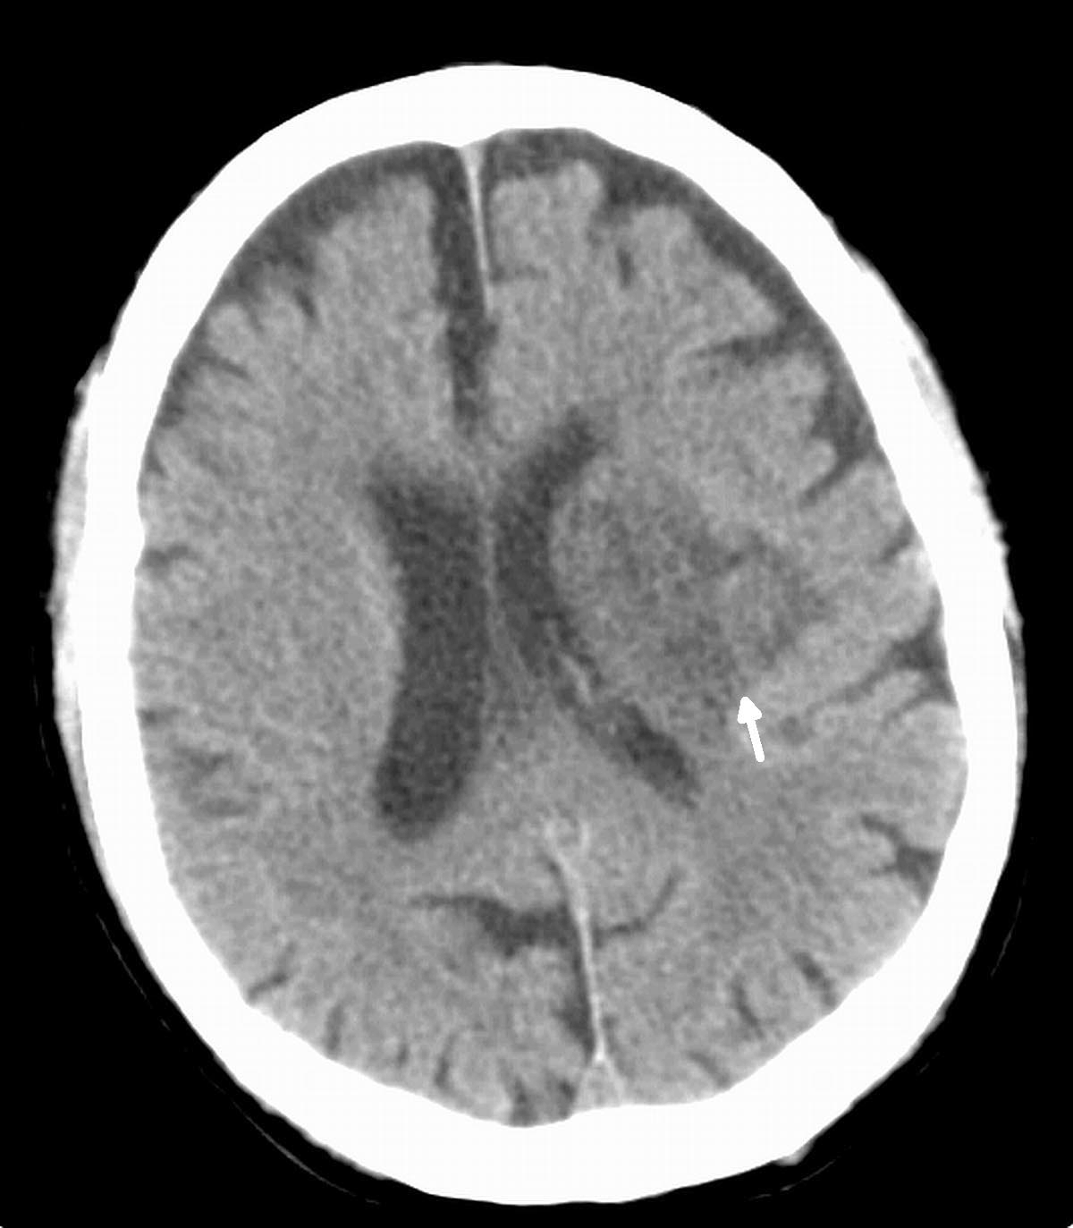
Trauma Changes the Brain and Response, Continued
The other thing to remember is that the stress hormone interferes with the way we are able to store memory
So we know that in trauma response or PTSD the trauma is continuing to live in the brain
This can impact behaviors, create triggers and if we understand this we can detect signs of trauma
Source: Specialized Training: Medical/Mental Health Care (Regional Training Files) Authors: National Commission on Correctional Healthcare (NCCHC), April 2013

Slide 54
Impact of Continuous Trauma for Inmates
Can create chronic hyper arousal
If constantly in fear of abuse or retaliation the brain begins to become hard-wired to respond immediately
The brain has an inability to calm down, a lot of anxiety, difficulty sleeping, irritability, impulsive behavior
These are all signs that could help you detect sexual abuse or fear of abuse/harassment
Source: Specialized Training: Medical/Mental Health Care (Regional Training Files) Authors: National Commission on Correctional Healthcare (NCCHC), April 2013.

Slide 55
Objective 3: Apply learning objectives 1 and 2 to fulfill your responsibility under agency sexual abuse and sexual harassment prevention and detection policies and procedures
To meet this objective we will discuss:
Prevention and detection strategies
Facility policies and procedures that support prevention and detection of sexual abuse and sexual harassment

Slide 56
Prevention Strategies
What does prevention mean to you?
How do you maintain safety each day through prevention?
How can this apply specifically to PREA and sexual safety?
What other ways can you prevent sexual abuse and sexual harassment now knowing what we discussed regarding dynamics and detection?
Notes:
http://www.prearesourcecenter.org/sites/default/files/library/preaessentials-prclibrary.pdf
shorter list of factors for consideration is required for lockups and community confinement facilities, specifically:
▪ The physical layout of the facility;
▪ The composition of the detainee/resident population (such as gender, age, security level, and length of time individuals reside in the facility);
▪ The prevalence of substantiated and unsubstantiated incidents of sexual abuse; and
▪ Any other relevant factors.
At
Supervision and monitoring in juvenile facilities
For secure juvenile facilities, Standard 115.313 requires a minimum staffing ratio of 1:8 for supervision during resident waking hours and 1:16 during resident sleeping hours. These ratios include only security 4
staff. Agencies may depart from these minimum ratios during limited and discrete exigent circumstances, which must be fully documented for audit purposes.
Non-secure juvenile facilities are not required to maintain a minimum staffing ratio.
In order to provide agencies with sufficient time to readjust staffing levels and, if necessary, request additional funding, any facility that, as of June 20, 2012, is not already obligated by law, regulation, or judicial consent decree to maintain the required staffing ratios shall have until October 1, 2017, to achieve compliance. Additionally, DOJ invites public comment on 115.313(c) though the Final Rule is still in effect. least annually, or more frequently if necessary, facilities must reassess, determine, and document whether adjustments to the staffing plan or resources devoted to supervision and monitoring are needed, making any necessary adjustments.
Youthful inmates:
Youthful inmates
The standards define a youthful inmate as “any person under the age of 18 who is under adult court supervision and incarcerated or detained in a prison or jail.” Standard 115.14 requires adult prisons and jails to house youthful inmates separately from adult inmates. However, agencies may manage this population outside of a housing unit if supervised directly by staff.
Facilities and agencies have flexibility in complying with this standard. For example, they can:
1. Confine all youthful inmates to a separate housing unit;
2. Transfer youthful inmates to a facility within the agency that enables them to be confined to a separate unit;
3. Enter into a cooperative agreement with an outside jurisdiction to enable compliance; or
4. Cease confining youthful inmates in adult facilities as a matter of policy or law.

Slide 57
Suggested Prevention Strategies
How Can You Participate in Prevention?
Enforcing the agency or facility policy on zero tolerance
Supporting the agency’s or facility’s sexual abuse reporting policy, if you see something suspicious you are expected to report
Paying attention to your surroundings (blind spots, unlocked closets, staffing shortages)
Other strategies?
Notes:
Steps for preventing a sexual incident

Slide 58
PREA Standards and Prevention Planning
PREA standards address general prevention planning by:
Identifying a PREA coordinator for your agency/facility (115.11)
Ensuring your agency does not hire or promote someone who has committed sexual abuse, as well as perform background checks of new and current staff (115.17)
Requiring contract providers to adopt PREA (115.12)
Ensuring your agency has multiple mechanisms for reporting abuse (115.51)
Ensuring there is adequate supervision and monitoring practices, taking into consideration several factors such as staffing levels, video monitoring, programming, privacy, prevalence of incidents (115.13)
Notes:
http://www.prearesourcecenter.org/sites/default/files/library/preaessentials-prclibrary.pdf
shorter list of factors for consideration is required for lockups and community confinement facilities, specifically:
▪ The physical layout of the facility;
▪ The composition of the detainee/resident population (such as gender, age, security level, and length of time individuals reside in the facility);
▪ The prevalence of substantiated and unsubstantiated incidents of sexual abuse; and
▪ Any other relevant factors.
At
Supervision and monitoring in juvenile facilities
For secure juvenile facilities, Standard 115.313 requires a minimum staffing ratio of 1:8 for supervision during resident waking hours and 1:16 during resident sleeping hours. These ratios include only security 4
staff. Agencies may depart from these minimum ratios during limited and discrete exigent circumstances, which must be fully documented for audit purposes.
Non-secure juvenile facilities are not required to maintain a minimum staffing ratio.
In order to provide agencies with sufficient time to readjust staffing levels and, if necessary, request additional funding, any facility that, as of June 20, 2012, is not already obligated by law, regulation, or judicial consent decree to maintain the required staffing ratios shall have until October 1, 2017, to achieve compliance. Additionally, DOJ invites public comment on 115.313(c) though the Final Rule is still in effect. least annually, or more frequently if necessary, facilities must reassess, determine, and document whether adjustments to the staffing plan or resources devoted to supervision and monitoring are needed, making any necessary adjustments.
Youthful inmates:
Youthful inmates
The standards define a youthful inmate as “any person under the age of 18 who is under adult court supervision and incarcerated or detained in a prison or jail.” Standard 115.14 requires adult prisons and jails to house youthful inmates separately from adult inmates. However, agencies may manage this population outside of a housing unit if supervised directly by staff.
Facilities and agencies have flexibility in complying with this standard. For example, they can:
1. Confine all youthful inmates to a separate housing unit;
2. Transfer youthful inmates to a facility within the agency that enables them to be confined to a separate unit;
3. Enter into a cooperative agreement with an outside jurisdiction to enable compliance; or
4. Cease confining youthful inmates in adult facilities as a matter of policy or law.

Slide 59
Detection
Notes:
Detection-know your environment

Slide 60
Detection Strategies
Take note of inmate behaviors and patterns
Address the inmate should their behavior become uncharacteristic or demonstrate signs discussed previously in this training
Take note of staff behaviors should they become uncharacteristic of the staff person
Develop a strategy with how you will address the staff person should their behavior become out of the ordinary
While we can refer to red flags to help guide prevention and detection these are not absolutes, but may indicate need for further response

Slide 61
Group Work: Agency/Facility Policies and Procedures
Identify in your PREA specific and related policies and/or procedures your responsibility in prevention and detection of sexual abuse
How does what you learned today help you fulfill your responsibilities under your policies in prevention and detection of sexual abuse and sexual harassment?
Are there additional elements in your policy that you should be aware of related to prevention and detection?

Slide 62
Review: Unit 3, Part I Objectives
Understand the dynamics of sexual abuse and sexual harassment in confinement settings
Learn how to detect signs of threatened and actual sexual abuse by understanding common reactions of victims of sexual abuse and sexual harassment and common behaviors of abusers
Apply learning objectives 1 and 2 to fulfill your responsibility under agency sexual abuse and sexual harassment prevention and detection policies and procedures

Slide 63

End of Unit 3, Part I

